Slide 1




Using Rust at Parity to Build Substrate to Build Polkadot

Slide 2
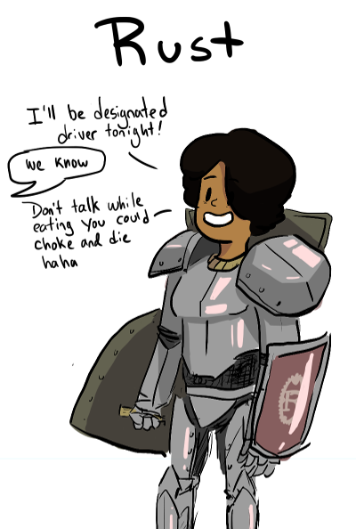
ROADMAP
-- Why I Love Rust
-- Technical Merit
-- Culture and Community
-- Parity
-- ETHCore Beginnings
-- Heterogeneous Sharding
=> Substrate => Polkadot

Slide 3
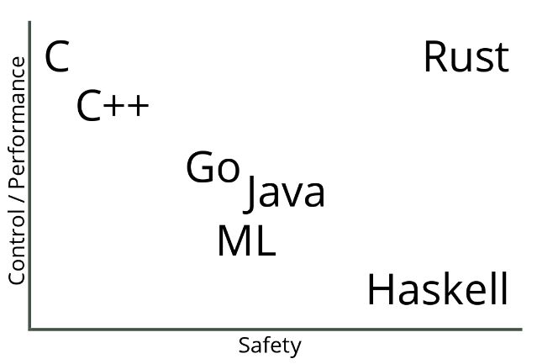
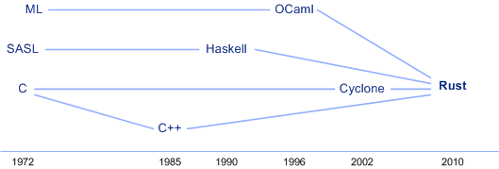
“A language that doesn’t affect the way you think about programming, is not worth knowing.” - Alan Perlis

Slide 4
Rust is a systems programming language that runs blazingly fast, prevents segfaults, and guarantees thread safety.
Featuring
zero-cost abstractions
move semantics
guaranteed memory safety
threads without data races
trait-based generics
pattern matching
type inference
minimal runtime
efficient C bindings

Slide 5
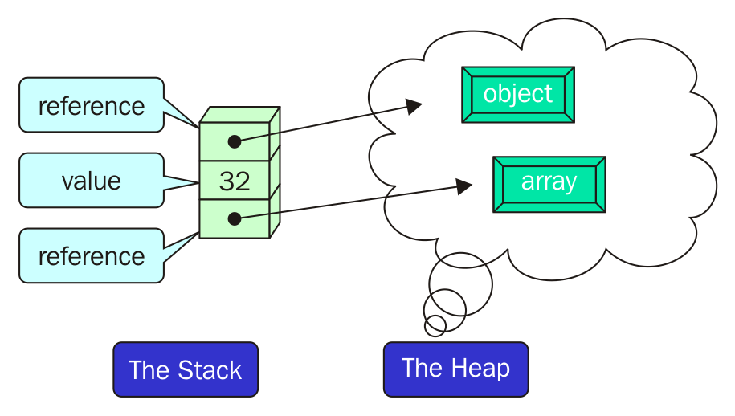
The Stack and the Heap

Slide 6
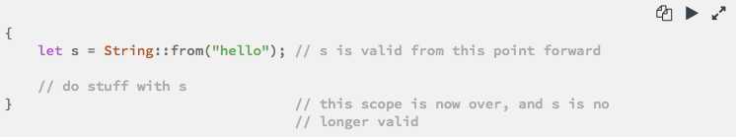
Safety, Speed, and Concurrency (1)
One of Rust’s most unique and compelling features is Ownership, which it uses to achieve memory safety.
Each value in Rust has a variable called its owner.
There can only be one owner at a time.
When the owner goes out of scope, the value will be dropped.

Slide 7
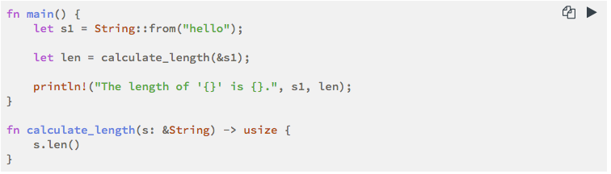
Safety, Speed, and Concurrency (2)
Rust creates memory pointers optimistically, checks memory pointers’ limited accesses at the compiler time with the usage of References and Borrowing.
We use references to pass a value to a function without transferring ownership
Using references as function parameters is known as borrowing.

Slide 8
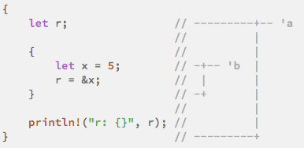
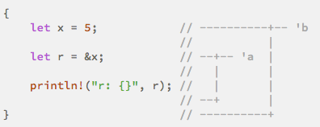
Safety, Speed, and Concurrency (3)
Automatic compile time memory management by checking the Lifetimes.
Every reference in Rust has a lifetime, which is the scope for which the reference is valid.
The Rust compiler has a borrow checker that compares the scopes to determine whether all borrows are valid.

Slide 9
“I call it my billion-dollar mistake. At that time, I was designing the first comprehensive type system for references in an object-oriented language...I couldn’t resist the temptation to put in a null reference, simply because it was so easy to implement. This has led to innumerable errors, vulnerabilities, and system crashes, which have probably caused a billion dollars of pain and damage in the last forty years.” - Tony Hoare (2009)
enum Option<T> {
Some(T),
None,
}
Because Option<T> and T are different types, the Rust compiler won’t allow us to use an Option<T> value as if it were definitely a valid value.

Slide 10
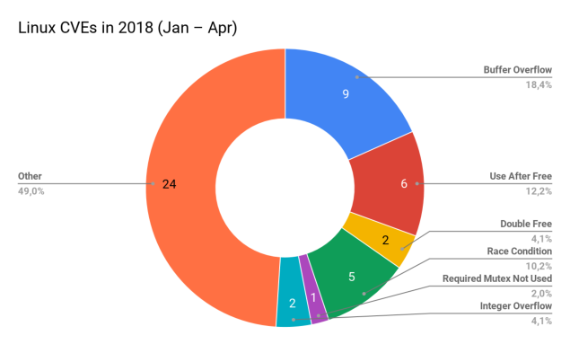
Memory Safety Issues are Impossible in Rust

Slide 11
Rust’s Culture and Code of Conduct (CoC)
Please be kind and courteous. There’s no need to be mean or rude.
We are committed to providing a friendly, safe and welcoming environment for all, regardless of level of experience, gender identity and expression, sexual orientation, disability, personal appearance, body size, race, ethnicity, age, religion, nationality, or other similar characteristic.
We will exclude you from interaction if you insult, demean or harass anyone.

Slide 12
Listening and Trust
I honestly despise being subtle or “nice”. The fact is, people need to know what my position on things are. And I can’t say “please don’t do that”, because people won’t listen. I say “On the internet, nobody can hear you being subtle”, and I mean it. - Linus Torvalds
“A code of conduct is not enough. Being ‘nice’ is not enough. We need to take a leap of faith and embrace humility and trust in our discussions...it’s vital for keeping our plural community whole and inclusive.” - Aaron Turon (aturon.log: listening and trust, part 2)

Slide 13
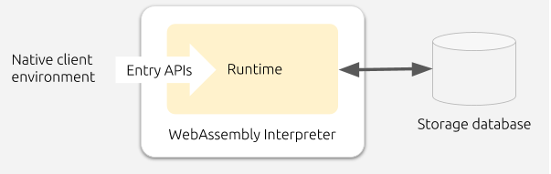
Why Parity chose WASM as the target
-- expands family of languages available to smart contract devs to include Rust, C/C++, C#, Typescript, Haxe, Kotlin
Additional benefits:
-- memory-safe, sandboxed, platform independent
-- supported by LLVM compiler infrastructure
-- continually developed by Google, Apple, Microsoft, Mozilla, and Facebook
-- high performance (designed to be as close to native machine code as possible while still being platform independent)

Slide 14
Substrate: Library to Build Blockchains
-- state machine, execution runtime, smart contracts
-- encryption, signatures, RNG, etc.
- consensus algorithms and fault tolerance voting
-- proof of waste, proof of stake, proof of authority
-- block structure, efficient storage, message serialization
-- p2p networking, peer discover, block and transaction gossip
-- light client support

Slide 15
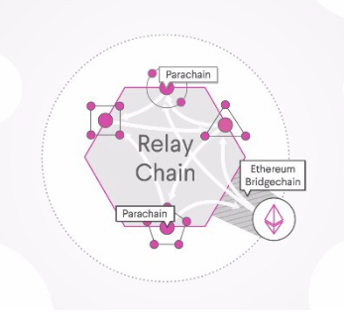
POLKADOT (bunch of Substrate blockchains)
“A parachain is a simpler form of blockchain, which attaches to the security provided by a ‘relay chain’ rather than providing its own. The relay chain [provides] security to attached parachains, but also provides a guarantee of secure message-passing between them.” -- Polkadot: The Parachain

Slide 16
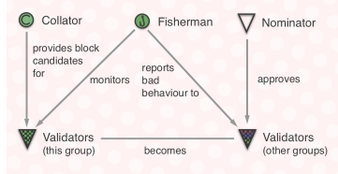
ROLES
A validator is the highest charge and helps seal new blocks on the Polkadot network. The validator’s role is contingent upon a sufficiently high bond being deposited, though we allow other bonded parties to nominate one or more validators to act for them and as such, some portion of the validator’s bond may not necessarily be owned by the validator itself but rather by these nominators.

